Slide 1
Processing of Imaging Mass Cytometry Data from Pancreatic Cancer Samples
Nathalia Kim
kim.n@queensu.ca
Notes:
Hello, today I will present my project “Processing of Imaging Mass Cytometry Data from Pancreatic Cancer Samples”.

Slide 2
Introduction
Notes:
To give an introduction on why pancreatic cancer and why this work is relevant, the graph on the top left shows how pancreatic cancer is aggressive and have a poor prognosis, where only 8% of all patients reach a 5-year survival compared to 60% for most of the cancers. The pie chart on the bottom right shows that pancreatic cancer is the forth most common cause of cancer-related deaths in the US. So this all reveal that pancreatic cancer is a devastating disease for which we don’t have a cure.
This scenario motivates many studies to better understand this disease. One of the relevant areas in the study of cancer is the tumor microenvironment, which is when you study the tumor in a subcellular resolution to investigate the types of cells that surround and cooperate with cancer cells and play a role in promoting tumor progression.

Slide 3
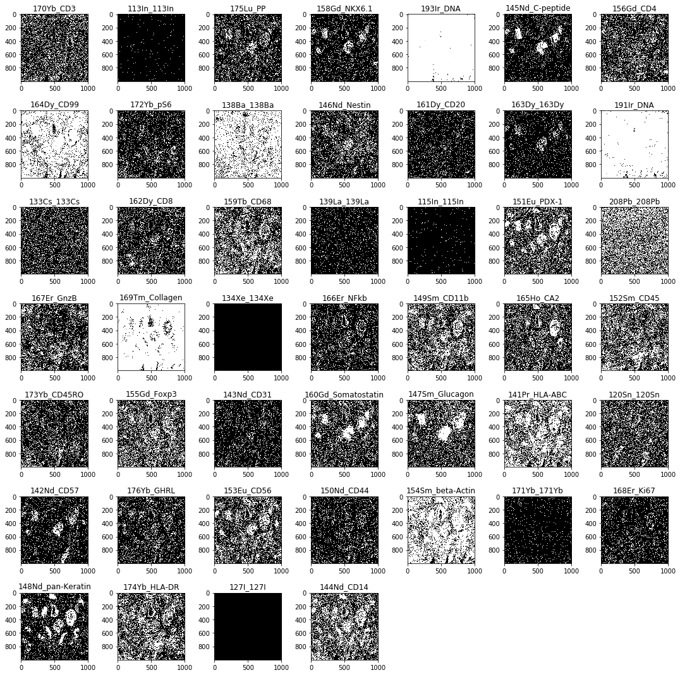
Dataset
Imaging mass cytometry (IMC) data
9 pancreata of pancreatic ductual adenocarcinoma (PDAC) patients
3 to 4 regions of interest (ROI) per sample
46 markers
Total of 36 ROIs and 1,656 images
Notes:
So that’s what was done in this project, I investigated the tumor microenvironment using imaging mass cytometry data obtained from 9 pancreata of PDAC patients. PDAC is a type of pancreatic cancer, the most common one.
In each tissue samples, 3 to 4 regions of interest were identified and 46 markers were measures. This resulted in 46 images similar to the ones in the picture. Here, each image name is composed by two parts, before the underscore is the heavy metal used to stain the tissue and after the underscore is the name of the marker itself. Some images that have the first and second parts the same represents controls. The white dots in the images represent the presence of that marker.
Therefore, the dataset consisted of 36 ROIs, that is, 36 sets of this 46 images which resulted in a total of 1,656 images.

Slide 4
Preprocessing
Notes:
In the preprocessing stage, the images were first normalized to a range of zero to one to set them to a common scale. Then, a median filter was applied for denoising and an automatic image thresholding was performed to get a binary image. Otsu thresholding was chosen since it was desired to preserve the edges. The last step was to transform the image to a vector size, storing in a vector the indexes of the pixels that had true values in the binary image. This vector was the input for the clusetering algorithm next.

Slide 5
Clustering
Detect structures in the images
DBSCAN clustering
Epsilon = 0.05
MinPts = 5
Resulting clusters from DBSCAN on a representative pan-Keratin image
Notes:
After preprocessing, DBSCAN clustering algorithm was employed to detect the structures formed by each marker in the images. An epsilon value of 0.05 and minimum points of 5 were used. This image shows the resulting clusters from DBSCAN on a marker called pan-Keratin. Here each cluster appear on different color tones.
The pan-Keratin marker is of great interest for this project, given that it can identify cancer cells in the PDAC environment. For this pan-Keratin image, DBSCAN found 41 different clusters.

Slide 6
Results and Discussion – Clustering
Resulting clusters on a representative ROI
Pink and white images resulted in only 1 cluster
Notes:
Now I will present the results of this project. The preprocessing steps and DBSCAN clustering were applied to the entire dataset. This figure shows the resulting clusters on a representative ROI. We can see that DBSCAN was able to identify the different clusters in most of the images, but some images are predominant pink or white, which means that only one cluster was found.
For the controls (such as 138Ba_138Ba and 171Yb_171Yb) this can be explained by the fact they are not biological markers and consist of mostly noise that could not be distinguished by the clustering algorithm. However, for some markers such as 193Ir_DNA it was not expected to obtain only one cluster, since it should be able to identify the nucleus of the cells.

Slide 7
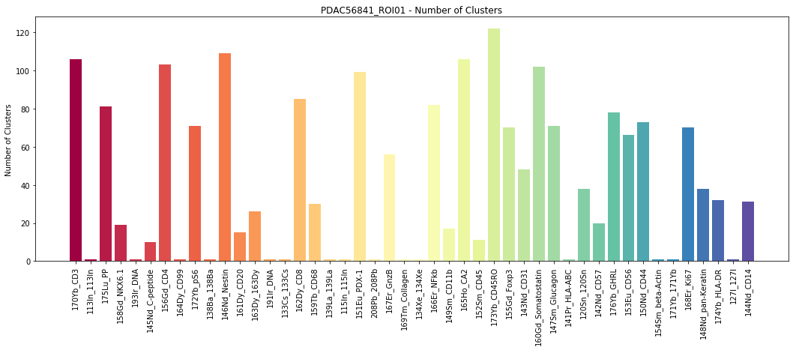
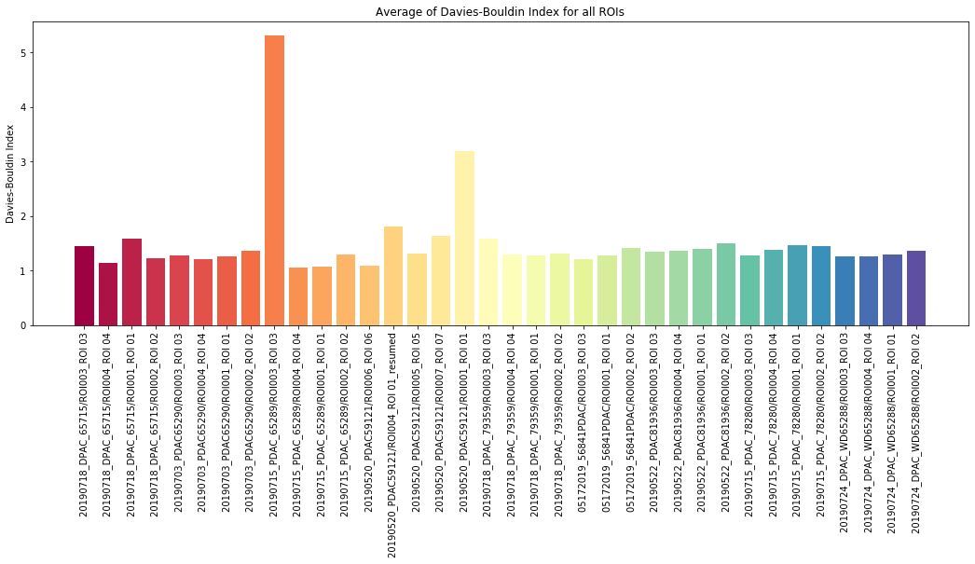
Results and Discussion - Measurements
Number of clusters of a representative ROI
Average of Davies-Bouldin index for all ROIs
Notes:
After the clustering, a set of measurements were taken for further analysis. The top graph shows the number of cluster of each marker for a representative ROI. As expected, the number of clusters had great variation between the different markers.
To evaluate the model performance the Davies-Bouldin index was chosen since the truth class assignments of the samples are not known and its computation is simpler than the silhouette coefficient. The bottom graph shows the average of Davies-Bouldin index for all ROIs. We can see that most of them fluctuate between 1.5 and 2, which is a little high. But, considering that the Davies-Bouldin index is usually higher for convex clusters and that some images have structures dissimilar from each other, the resulting indexes can be considered satisfactory.

Slide 8
Results and Discussion – Comparative Analysis
Comparison between pan-Keratin and CD3 markers
Notes:
Finally, a comparison between the pan-Keratin and CD3 markers was performed for all ROIs. As mentioned before, the pan-Keratin marker can identify cancer cells in PDAC. On the other hand, CD3 marker could indicate the presence of T cells in the tissue, which is a type of immune cells.
As pictured in the figure, the number of clusters of CD3 is higher than of pan-Keratin for the majority of ROIs. However, the total area of clusters of pan-Keratin is usually greater than CD3. This could indicate that the presence of CD3 markers is more sparse in PDAC tissue while the pan-Keratin marker represent regions of high density of tumor cells.
It is also noteworthy in the bottom graph that the ROIs that have the highest total area of clusters of CD3 also have low total area of pan-Keratin. This suggests that an inhibition of the infiltration of T cells could be produced by the presence of tumor cells. This inhibition could affect the immune system’s ability to prevent tumor progression.

Slide 9
Conclusions
DBSCAN clustering on IMC data has proven capable of identifying the different structures of the markers
There are limitations to this study and room for improvements
Cancer cells could inhibit the infiltration of T cells and thus affect tumor progression
Data can be additionally interrogated in a future work
Notes:
To conclude, the application of DBSCAN clustering on IMC data has proven capable of identifying the different structures of the markers.
However, it is acknowledged there are limitations to this study and room for improvements. For example, the fact that the DNA marker resulted in only one cluster is something that should be further investigated and the high levels of the Davies-Bouldin index can be explained to some sense by the nature of the data but could indicate that another evaluation would be a better choice.
Also, by comparing the pan-Keratin and CD3 markers, the results suggest that the presence of cancer cells could inhibit the infiltration of T cells and thus affect tumor progression.
And to finish, with the data collected from this project there’s already room for subsequent analysis and the images can be additionally interrogated employing different data analytics methods, which is intended to be addressed in a future work.

Slide 10
Thank you! Questions?
E-mail: kim.n@queensu.ca
Notes:
Thank you very much for the attention. Any questions?

